Slide 1


IPL AUCTION DATA ANALYSIS
By Shreya Ankush

Slide 2

Data set and Table
CREATE TABLE IPL_BALL
(id int, inning int, over int, ball int, batsman varchar, non_striker varchar,bowler varchar,batsman_runs int, extra_runs int, total_runs int,is_wicket int, dismissal_kind varchar,player_dismissed varchar, fielder varchar, extras_type varchar, batting_team varchar,bowling_team varchar);
COPY IPL_BALL ("id","inning","over","ball","batsman","non_striker","bowler","batsman_runs","extra_runs","total_runs","is_wicket","dismissal_kind","player_dismissed","fielder","extras_type","batting_team","bowling_team")
FROM 'C:\Program Files\PostgreSQL\16\data\dataset\IPL Dataset\IPL_Ball.csv' DELIMITER ',' CSV HEADER;

Slide 3
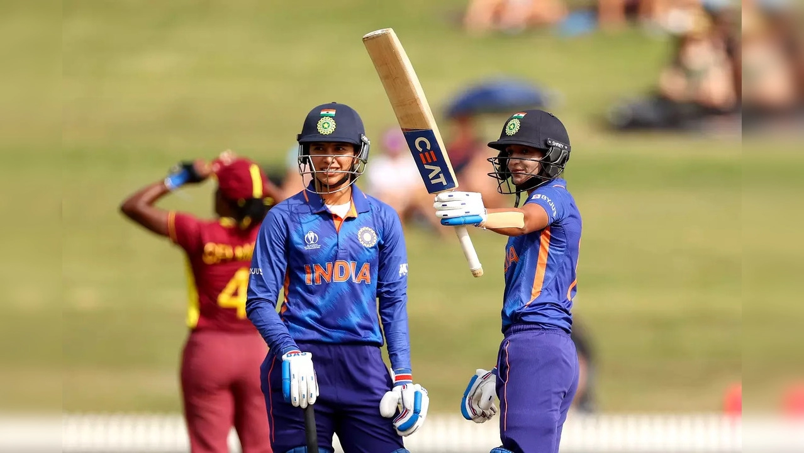
Bidding on batters

Slide 4
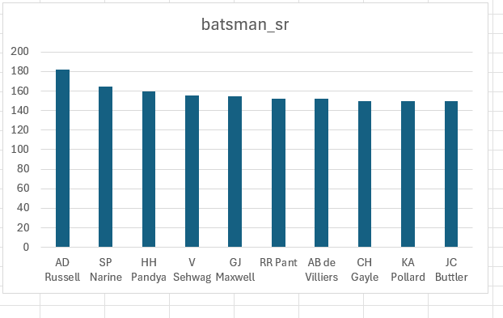
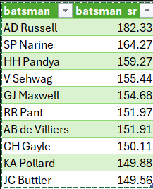
List of 10 Players with high strike rate who have faced at least 500 balls
SELECT batsman,ROUND((SUM(batsman_runs)*1.0 / COUNT(ball)) * 100,2) AS batsman_sr
FROM ipl_ball
WHERE extras_type not in ('wides’)
GROUP BY batsman
HAVING COUNT(ball) > 500
ORDER BY batsman_sr DESC
LIMIT 10;
AGGRESSIVE BATTERS

Slide 5
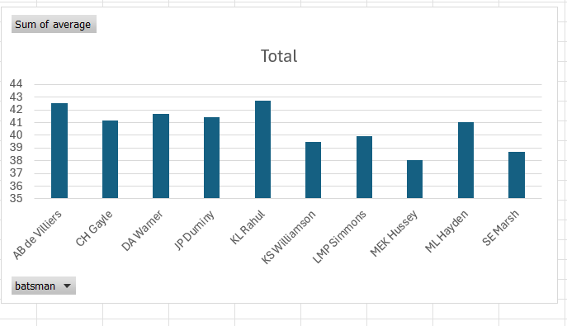
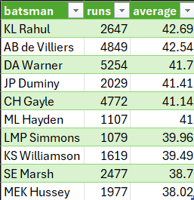
List of 10 players with good average who have played more than 2 ipl seasons
SELECT batsman,SUM(batsman_runs) AS runs,ROUND(SUM(batsman_runs)*1.0/SUM(is_wicket),2) AS average
FROM ipl_ball
GROUP BY batsman
HAVING SUM(is_wicket) > 0 AND COUNT(DISTINCT id) > 28
ORDER BY average DESC
LIMIT 10;
ANCHOR BATSMEN

Slide 6
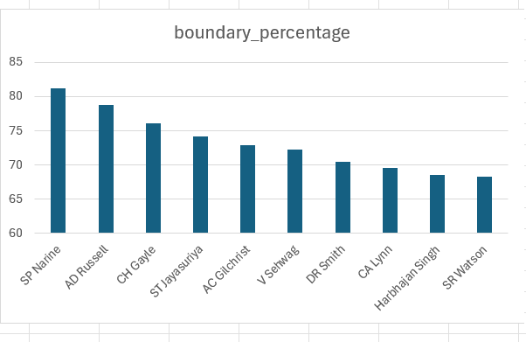
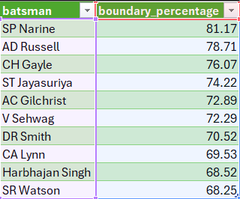
List of hard-hitting players who have scored most runs in boundaries and have played more than 2 ipl seasons.
SELECT batsman, ROUND(SUM(CASE WHEN batsman_runs in(4,6) THEN batsman_runs else 0 END)*1.0 / SUM(batsman_runs)*100,2) AS boundary_percentage
FROM ipl_ball
WHERE extras_type NOT IN ('wides’)
GROUP BY batsman
HAVING COUNT(DISTINCT id) > 28
ORDER BY boundary_percentage DESC
LIMIT 10;
HARD HITTERS

Slide 7

Bidding on bowlers

Slide 8
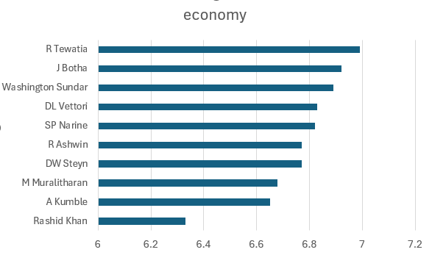
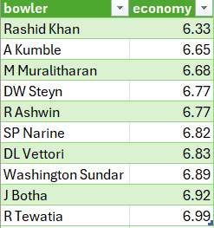
List of bowlers with good economy who have bowled at least 500 balls in ipl so far.
SELECT bowler, ROUND(SUM(total_runs)/(COUNT(bowler)/6.0), 2) as economy
FROM ipl_ball
GROUP BY bowler
HAVING COUNT(bowler) > 500
ORDER BY economy
LIMIT 10;
GOOD ECONOMY BOWLERS

Slide 9
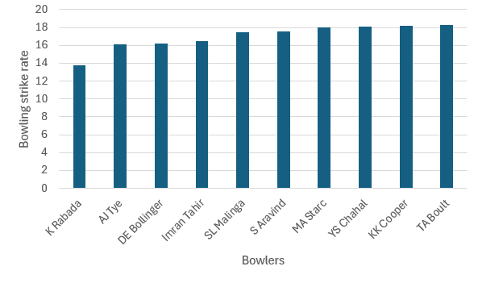
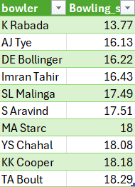
List of bowlers with the best strike rate and who have bowled at least 500 balls in ipl so far.
WITH ValidDismissals AS (SELECT bowler, is_wicket,
CASE WHEN dismissal_kind IN ('bowled', 'caught', 'caught and bowled', 'hit wicket', 'lbw’, 'stumped') THEN 1
ELSE 0
END AS is_valid_dismissal
FROM ipl_ball)
SELECT bowler, ROUND(COUNT(bowler) * 1.0 / SUM(is_valid_dismissal),2) AS economy
FROM ValidDismissals
GROUP BY bowler
HAVING COUNT(bowler) > 500
ORDER BY economy
LIMIT 10;
BOWLERS WITH BEST STRIKE RATE

Slide 10
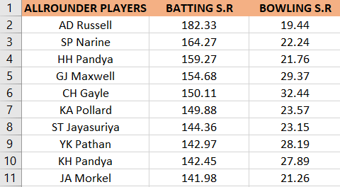
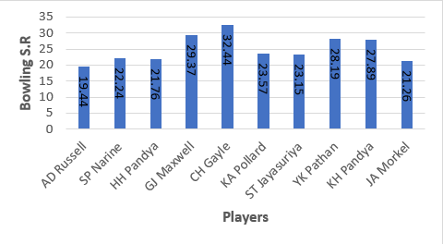
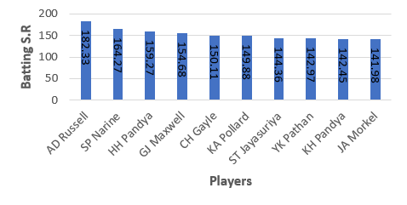
List of all_rounders with the best batting as well as bowling strike rate and who have faced at least 500 balls in ipl so far have bowled minimum 300 balls.
SELECT a.batsman AS all_rounder, a.batsman_sr, b.bowling_sr
FROM batting_sr a
INNER JOIN
bowling_sr b ON a.batsman = b.bowler
ORDER BY a.batsman_sr DESC, b.bowling_sr ASC
LIMIT 10;
ALL-ROUNDERS

Slide 11
Criteria for selecting WICKETKEEPERS in the IPL
Batting Ability: Wicketkeepers is often expected to contribute to the team’s run total with aggressive batting, emphasis is on scoring runs quickly.
Agility and Glovework: Strong wicketkeeping skills are vital. Look for wicketkeepers with quick reflexes, clean catching ability, and accurate stumpings.
Fielding: Prioritize wicketkeepers with excellent fielding skills, capable of creating run-out opportunities.
Versatility: Choose wicketkeepers who can adapt to different match scenarios and contribute effectively to various batting positions.
Consistency: Look for wicketkeepers with a consistent track record, both in batting and wicketkeeping, to ensure stable performance throughout the tournament.

Slide 12

Additional questions

Slide 13
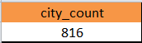
1. Get the count of cities that have hosted an IPL match.
select count(city) as city_count
from IPL_matches;

Slide 14
2. Create table deliveries_v02 with all the columns of the table ‘deliveries’ and an additional column ball_result containing values boundary, dot or other depending on the total_run (boundary for >= 4, dot for 0 and other for any other number)
CREATE TABLE deliveries_v02 AS
SELECT *,
CASE
WHEN total_runs >= 4 THEN 'boundary’ WHEN total_runs = 0 THEN 'dot’ ELSE 'other’
END AS ball_result
FROM ipl_ball;
select * from deliveries_v02;

Slide 15
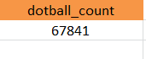
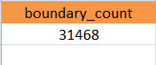
3. Write a query to fetch the total number of boundaries and dot balls from the deliveries_v02 table.
select count(ball_result)as Dotball_count
from deliveries_v02
where ball_result='dot’ ;
select count(ball_result)as boundary_count from deliveries_v02
where ball_result='boundary' ;

Slide 16
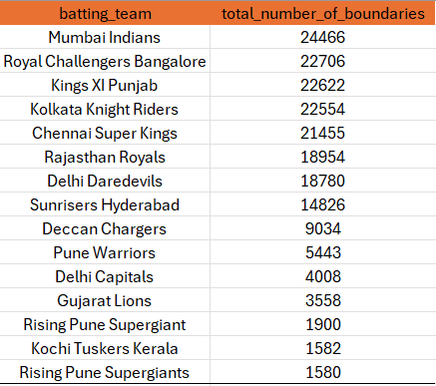
4. Write a query to fetch the total number of boundaries scored by each team from the deliveries_v02 table and order it in descending order of the number of boundaries scored.
select batting_team, count('boundary') as total_number_of_boundaries
from deliveries_v02
group by batting_team
order by total_number_of_boundaries desc;

Slide 17
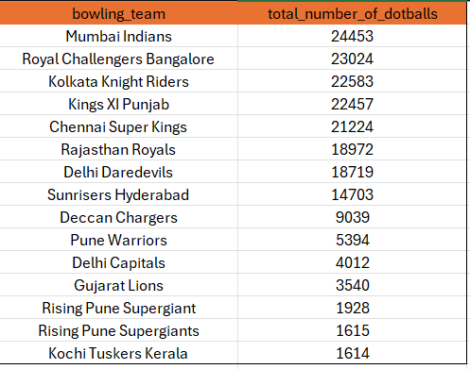
5. Write a query to fetch the total number of dot balls bowled by each team and order it in descending order of the total number of dot balls bowled.
select bowling_team, count('dot') as total_number_of_dotballs from deliveries_v02group by bowling_teamorder by total_number_of_dotballs desc;

Slide 18
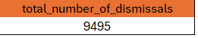
6. Write a query to fetch the total number of dismissals by dismissal kinds where dismissal kind is not NA.
select count(dismissal_kind) as Total_number_of_dismissals
from deliveries_v02
where not dismissal_kind='NA';

Slide 19
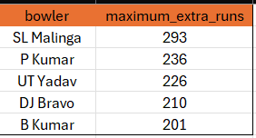
7. Write a query to get the top 5 bowlers who conceded maximum extra runs from the deliveries table.
select bowler, sum(extra_runs) as maximum_extra_runs from deliveries_v02
group by bowler
order by maximum_extra_runs desc
limit 5;

Slide 20
8. Write a query to create a table named deliveries_v03 with all the columns of deliveries_v02 table and two additional column (named venue and match_date) of venue and date from table matches.
CREATE TABLE deliveries_v03 AS
SELECT d.*, m.venue,
EXTRACT(DAY FROM m.date) AS date
FROM deliveries_v02 d
LEFT JOIN
IPL_matches m ON d.id = m.id;
select * from deliveries_v03 ;

Slide 21
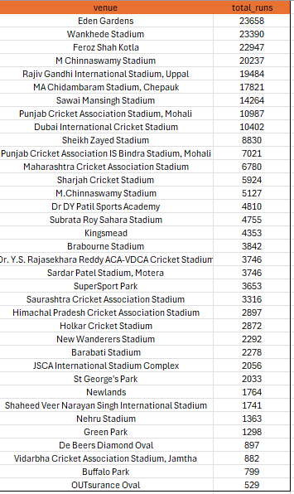
9. Write a query to fetch the total runs scored for each venue and order it in the descending order of total runs scored.
select venue,sum(total_runs) as Total_runs
from deliveries_v03
group by venue
order by Total_runs desc;

Slide 22
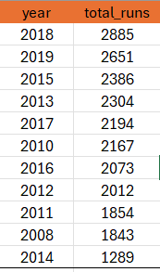
10. Write a query to fetch the year-wise total runs scored at Eden Gardens and order it in the descending order of total runs scored.
select Year, sum(total_runs) as Total_runs
from deliveries_v03
where venue = 'Eden Gardens’
group by Year
order by Total_runs desc ;

Slide 23
Thank you

